Slide 1


Full Stack Self-Service Diagnostics with Dynatrace
Wayne Segar
Senior Architect
Matt Miller
Title
Chris Schwarzbauer
Title

Slide 2
Agenda
Formalities
Introductions
What we’re covering
Level of Expertise required
Individual EC2 Instances
EasyTravel – Book Exciting travel to far away destinations
Setup and Launching our EC2 instance with EasyTravel
Configuration API
Use Case 1 – CPU Increase
Use Case 2 – Booking Failure
Use Case 3 – Slow Login
Use Case 4 – Homepage Slowdown
Tips and Tricks

Slide 3
What we’re covering/not covering
This is an exploration of common
This is not a product tutorial
This is not a test
There is no need to be an AWS expert and everything we are covering can be applied to ANY environment (e.g. Azure, GCP, Kubernetes, On-Prem, etc…)
The goal of this sessions is:
Help you become more comfortable using Dynatrace to diagnose application problems
Make the diagnosis easy for others in your organization
Not everybody needs to be a “Dynatrace Expert”

Slide 4
How we’re covering
We will walk through several Use Case Problem patterns
Each Student will have their own private EC2 instance running a version of EasyTravel (created via CloudFormation)
Each Student will have their own private Dynatrace SaaS tenant
Tenant ID and Credentials on your attached card
During the course of this session we will be doing the following:
Creating our environment via CloudFormation
Performing Dynatrace configurations via the UI and the API
Triggering EasyTravel Problem Patterns via the EasyTravel Config UI

Slide 5
Level of Expertise
Basic Dynatrace familiarity
Expert certification not required
REST API basics

Slide 6
Setup Work

Slide 7
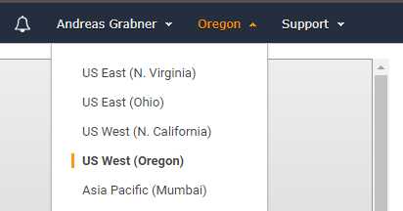
Setup AWS: Default Region
Login to your AWS Account: http://aws.amazon.com
Validate and make note of your default region

Slide 8
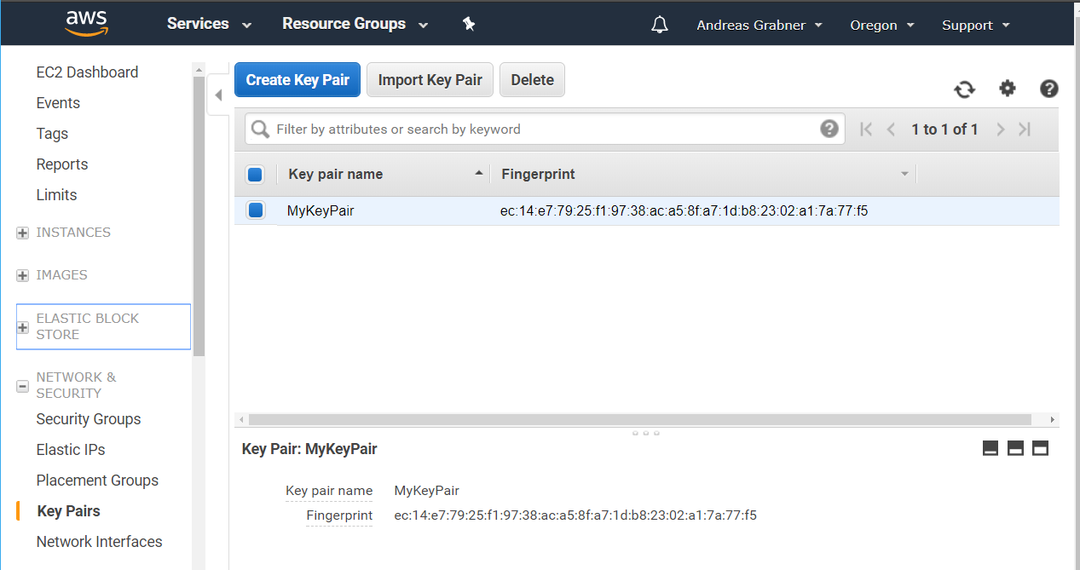
Setup AWS: EC2 Key Pair
Create EC2 Key Pair
Go to EC2 – Pick Region
Click on Key Pair
Create a new Pair
Store the .pem file

Slide 9
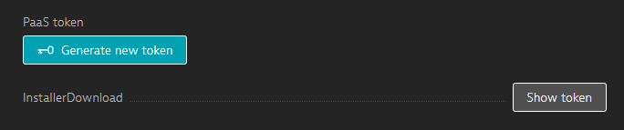
Setup Dynatrace: Retrieve API Token
Login to your Dynatrace SaaS Tenant gave you:
https://<TENANT_ID>.sprint.dynatracelabs.com
Navigate to:
Click “Deploy Dynatrace” from the left side menu
Click “Start Installation”
Click “Set up PaaS monitoring”
Click “Show token”
Copy your token to your clipboard

Slide 10
Launching our EC2 Instance
Our CloudFormation Template will create a Production Linux server with EasyTravel installed/running and deploy a OneAgent pointing to your Dynatrace SaaS Tenant

Slide 11
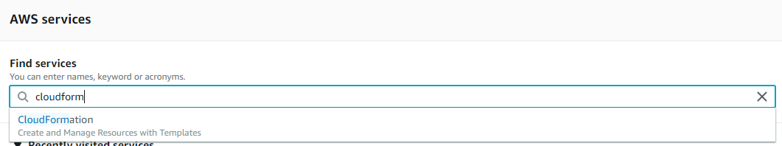
Launching the CloudFormation Stack
Launching the Stack
Upload Template
Filling in the Details
Confirm and Create
Follow Events
View Outputs
What is CloudFormation?
A declarative way to define AWS Resources, e.g: EC2, CodeDeploy, CodePipeline, Lambda, Roles, ELBs, …
Learn more about CloudFormation: https://docs.aws.amazon.com/AWSCloudFormation/latest/UserGuide
Our Steps
In your AWS Console browse to the CloudFormation Service

Slide 12
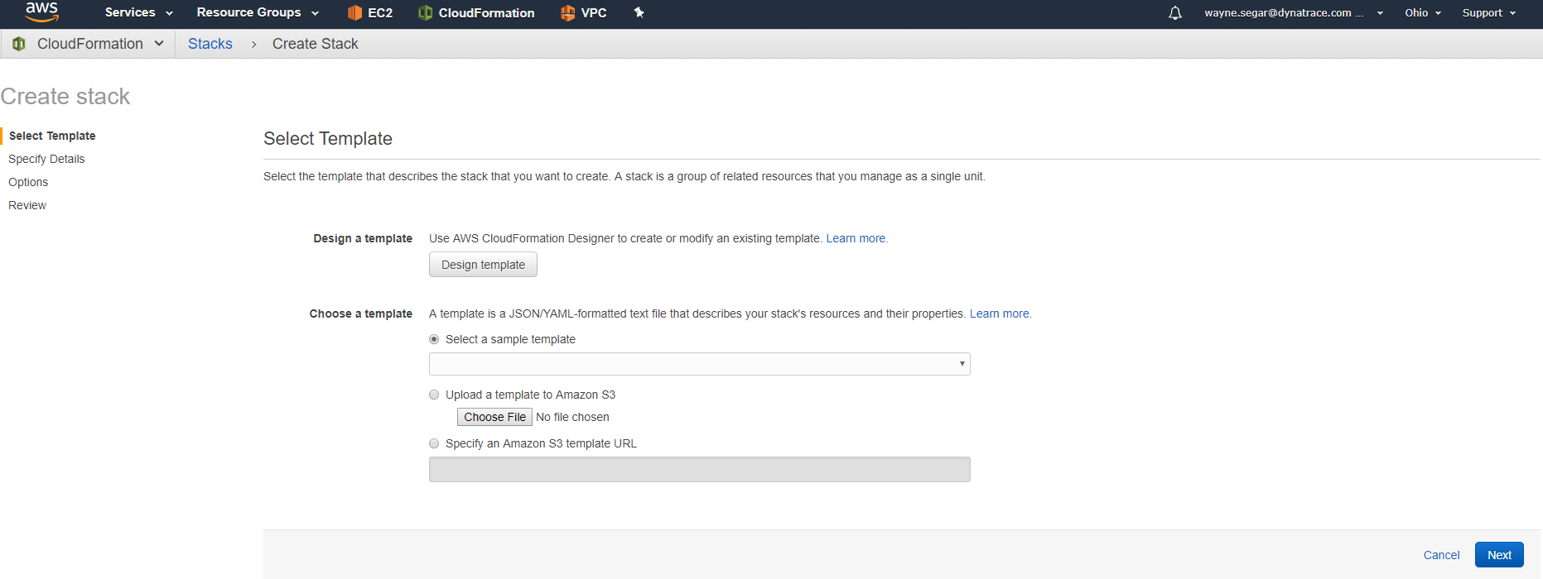
Upload Template
Launching the Stack
Upload Template
Filling in the Details
Create and Confirm
Follow Events
View Outputs
#1 Your region
#2 Enter Template URL
Template URL: https://bit.ly/2D3trMv

Slide 13
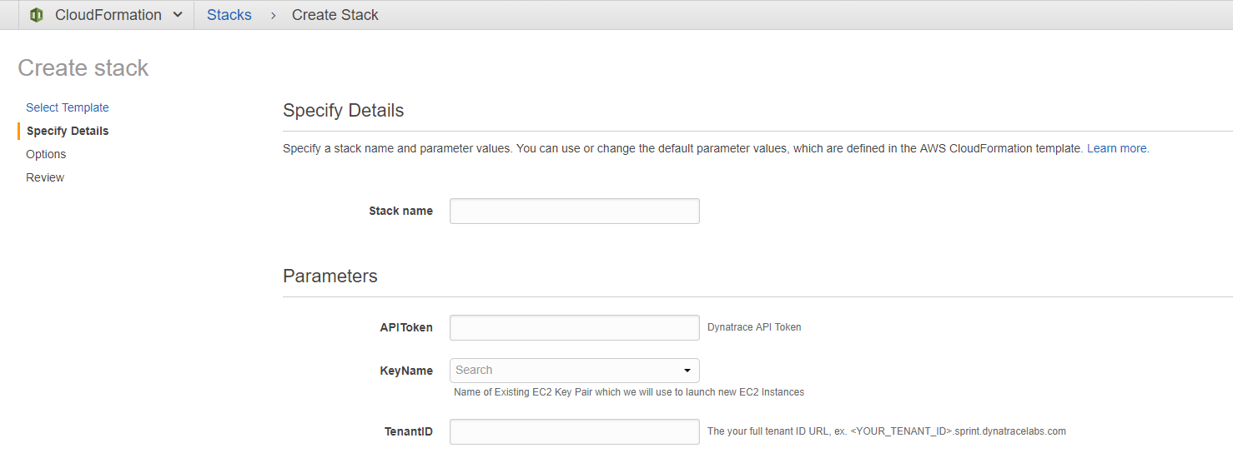
Filling in the Details
Launching the Stack
Upload Template
Filling in the Details
Create and Confirm
Follow Events
View Outputs
Any name, e.g: dynatracehotday
Your Dynatrace API Token
Your AWS EC2 Key Pair
Your Dynatrace Tenant URL

Slide 14
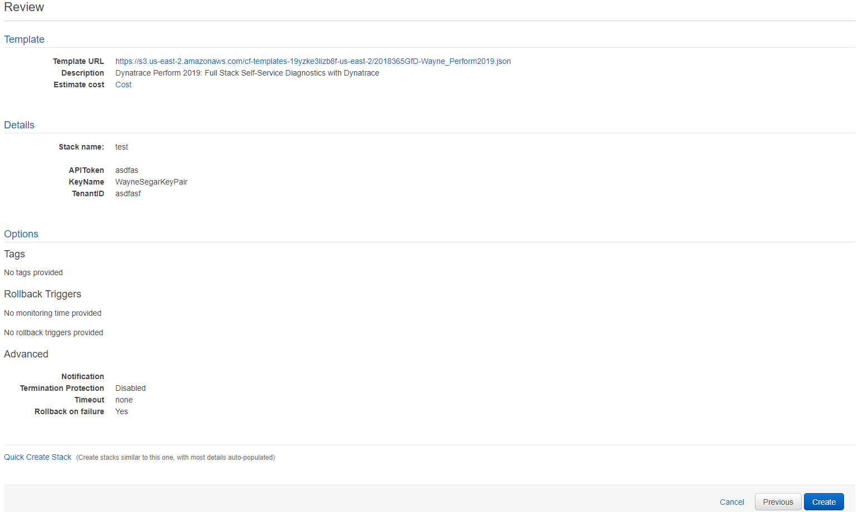
Create and Confirm
Launching the Stack
Upload Template
Filling in the Details
Create and Confirm
Follow Events
View Outputs

Slide 15
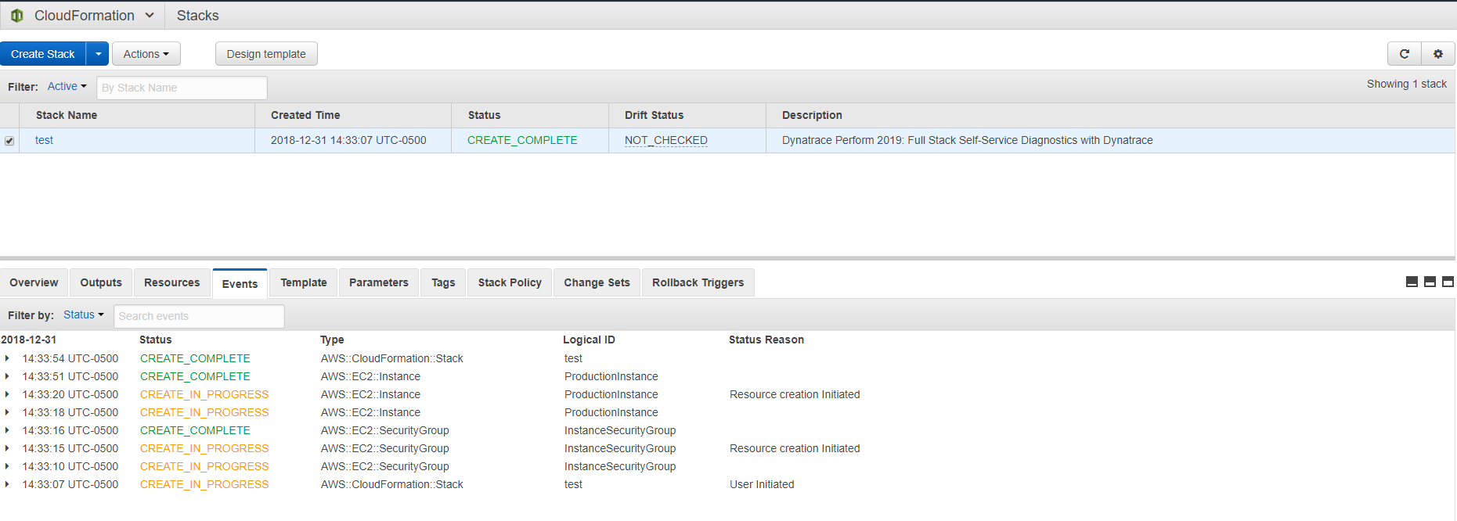
Follow Events
Launching the Stack
Upload Template
Filling in the Details
Create and Confirm
Follow Events
View Outputs
Watch as AWS Resources get created

Slide 16
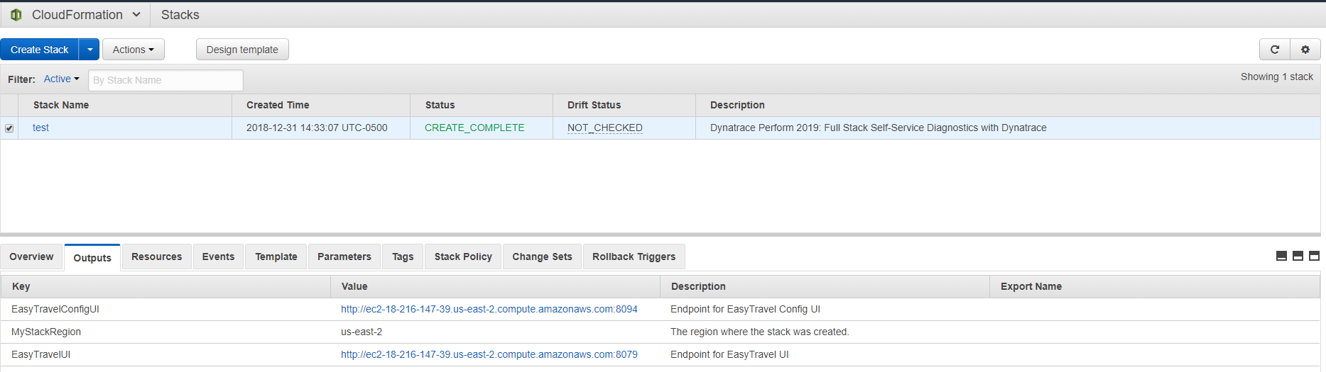
View Outputs
Launching the Stack
Upload Template
Filling in the Details
Create and Confirm
Follow Events
View Outputs
View Output URLs
Note: It will take roughly 10 minutes for EasyTravel to fully come up

Slide 17
Things to be done in tenant
Disable service monitoring of weblauncher process
Enable Hotsensor Placement
Change User Action Naming for Default XHR actions to “User Input”

Slide 18
Configuration API

Slide 19
Dynatrace Configuration API
The Dynatrace Configuration API allows API consumers to globally read and write the configuration settings of any Dynatrace environment
The primary use cases for the Configuration API are:
Read and copy an existing environment configuration over to a new environment.
Create or change individual configuration settings via the API when setting up a new environment.
Read and store configurations, along with their histories, in a version management system (for example, Git).
Provide an a mechanism to automate Monitoring/Performance-as-a-Service
Provide easy access to meaningful data to Application Owners with creation of Management Zones
Simplify complex environment with auto tagging rules
Extract specific business context information with request attributes

Slide 20
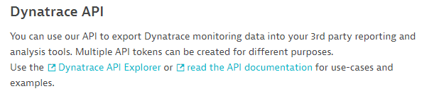
View the Configuration API Explorer
In your Dynatrace tenant navigate to:
Settings > Integration > Dynatrace API
Click “Dynatrace API Explorer”

Slide 21
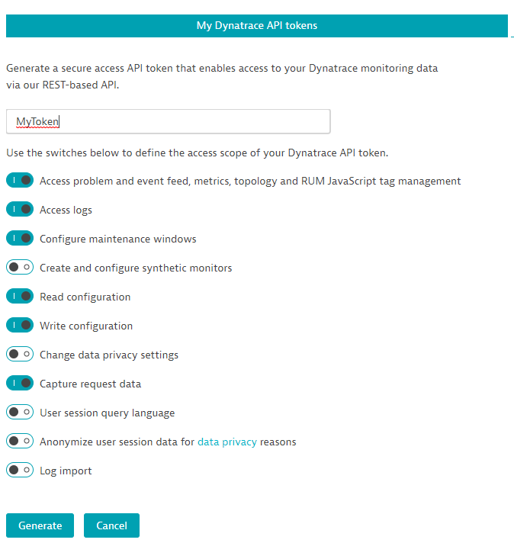
Create API Token to use the Config API
In the Dynatrace API screen, click “Generate token”
Enter a name for your token (ex. MyToken)
Make sure to enable the following switches
Click the “Generate” button

Slide 22
TODO: Figure out use case for Config API
Initial thoughts:
Create Auto tagging rules for various components of EasyTravel
Create Management Zones for different components of EasyTravel
Frontend
Backend
Infrastructure components
Custom Service
Credit Card Verification
CheckDestination
Request Attributes
easyTravel Destination
easyTravel User

Slide 23
Use Case #1 – CPU Increase
Notes:
Problem: CPULoad

Slide 24
Use Case #1 – CPU Increase
Background
EasyTravel is the main revenue generating application for booking travel. After a recent deployment to one of the components, your team notices that CPU usage is much higher than usual. This of course could impact users attempting to book travel on our site.
Investigate and figure out why this is happening
How would you instruct the Dev team to go about finding the problem and triaging it?

Slide 25
Use Case #1 – CPU Increase (cont.)
How to investigate the problem:

Slide 26
Use Case #2 – Booking Failure
Notes:
Problem: CreditCardCheckError500

Slide 27
Use Case #2 – Booking Failure
Background
The Marketing Department just called in a panic that bookings dropped to near zero over the past few minutes! Obviously, this is a pretty big issue because the core business is being impacted.
Investigate and figure out why this is happening
How would you instruct the Dev team to go about finding the problem and triaging it?

Slide 28
Use Case #2 – Booking Failure (cont.)
How to investigate the problem:

Slide 29
Use Case #3 – Slow User Login
Notes:
Problem:DBSpammingAuthWithAppDeployment

Slide 30
Use Case #3 – Slow User Login
Background
After a recent deployment to a component of EasyTravel customers are beginning to call the helpdesk and complain that logging in to view/book travel is “slow”.
Investigate and figure out why this is happening
How would you instruct the Dev team to go about finding the problem and triaging it?

Slide 31
Use Case #3 – Slow User Login (cont.)
How to investigate the problem:

Slide 32
Use Case #4 – Homepage Slowdown
Notes:
Problem: JourneyUpdateSlow

Slide 33
Use Case #4 – Homepage Slowdown
Background
The Operations team is claiming that the Special-Offers.jsp and ‘CalculateRecommendations’ pages are experiencing a significant increased response time. VP of Operations is not happy. Your job is to find out what’s going on with these pages. Some other pages may also be affected.
Investigate and figure out why this is happening
How would you instruct the Dev team to go about finding the problem and triaging it?

Slide 34
Use Case #4 – Homepage Slowdown (cont.)
How to investigate the problem:

